Slide 1

Barriers to Communication
By
Puneet Narang

Slide 2
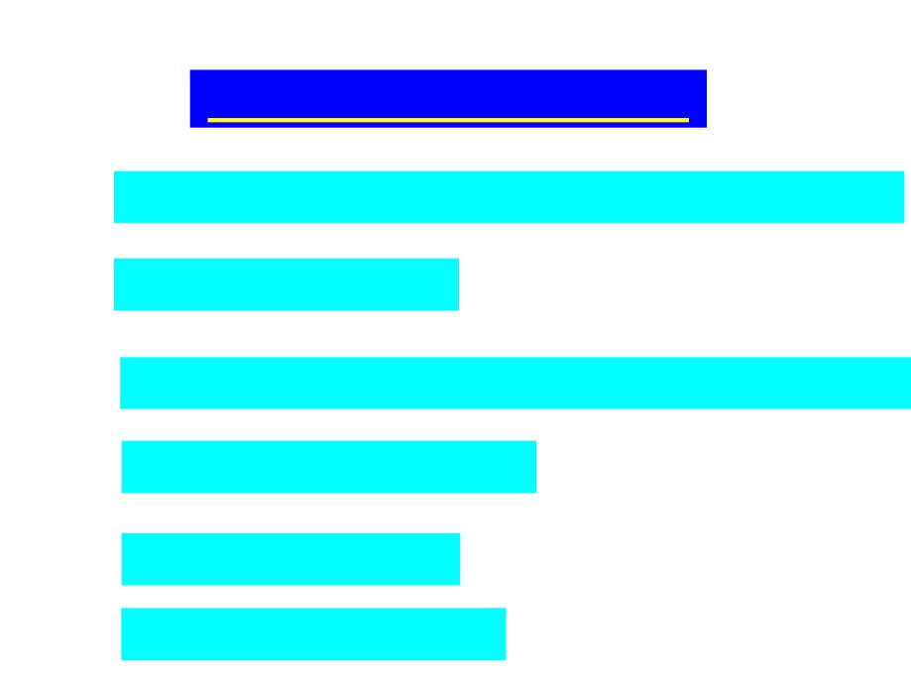
Contents of Presentation
⬄
Physical/ Environmental Barriers
⬄
Linguistic Barriers
⬄
Psychological Barriers
⬄
Socio-cultural Barriers
⬄ Technical Barriers
⬄ How to Overcome barriers

Slide 3

Introduction to Barriers to Communication
When the flow of communication gets impeded, it is termed as communication barrier.
During communication, there occur a number of barriers which prevent the achievement of desired result.
These include:
Physical
barriers;
Linguistic
barriers;
Psychological barriers; Socio-cultural barriers and Technical barriers

Slide 4

Barriers to communication.
1. Physical/Environmental Barriers: These barriers are related to the physical environment where the communication takes place. Such as
➢Physical Distance between the communicators ➢Noise in the environment
➢Improper seating arrangement ➢Inadequate level of illumination
➢High level of humidity leading to a sense of discomfort

Slide 5

Barriers to communication.
2.Linguistic Barriers: Breakdown in
communication occurs when the communicator
does not possess adequate competence with
regard to language. Such as:
a) Selection of wrong language: It leads to
misunderstanding;
Even
well
planned
communication fails.
b) Vocabulary: Limited vocabulary and difficult
vocabulary individually and together may lead to
miscommunication.

Slide 6

Barriers to communication
Linguistic Barriers Cont:
c) Semantics: As a word can have multiple meanings , hence sender and receiver attach different meanings leading to misinterpretation.
d) Jargons: A set of vocabulary that only the member of a specific group or professional can
understand, if used for unfamiliar group can
act as barrier .

Slide 7

Barriers to communication
3. Psychological Barriers: The following are the psychological barriers that can affect communication effectiveness.
a) Information filtering: A message gets altered in its intent moving from person to person as
every receiver eliminates or adds some portion of data in decoding it and further encoding it take to another receiver. This is because of psychological status of a man.

Slide 8

Barriers to communication
Psychological Barriers contd.
b) Lack of trust and openness: Both sender and
receiver must have trust in each other if positive
communication has to be initiated. Also an environment of openness encourages giving and
receiving
feedback
leading
to
better
communication. Thus lacking trust and openness are detrimental to effective communication.
c) Jealousy: Because of jealousy, people may communicate wrong messages to each other.

Slide 9

Barriers to communication
Psychological Barriers contd.
d) Pre-occupation: Some people being preoccupied with themselves hardly hear the message they are
listening to. This causes loss in the impact and purpose
of communication.
e) Frame of reference: Our differences in past
experience, educational background, emotions, values,
beliefs and many other factors all affect our perception of a message or the intent of the words.
f) Differing Attitudes between sender and receiver may lead to conflicts, hence communication suffers.
g) Mental fatigue may also act as barrier to effective communication.

Slide 10

Barriers to communication
Socio - Cultural Barriers
a) Cultural Divergence: Breakdowns in communication are also caused by cultural divergences. People may
interpret both verbal and non-verbal communication
differently in context of their culture.
b) Stereotypes: It refers to judging the communicator on the basis of their membership of to a particular group such as caste, region, religion etc. As generally these judgments are negative, hence lead to biases in communication.

Slide 11

Barriers to communication
Technical Barriers:
a. Timing: To have right impact of communication and desirable outcome, the determination of timing of
transmitting a message is very crucial. For example
delay in conveying an important message may be detrimental to the desirable outcome.
b. Lack of proper planning: When we start communicating without thinking and planning, we may fail to clearly state the purpose of the message.
This results in miscommunication and partial
breakdown in the process of communication.

Slide 12

Barriers to communication
Technical barriers
c. Overloaded information: When excessive information is provided in too little time, an individual may be unable to absorb, results in breakdown in communication.
d. Problem in Transmission channel may be another technical barrier to effective
communication.

Slide 13

How to Overcome Barriers to communication
The following steps can be taken to ensure effective communication:
➢ Choose right environment for communication which is free from distractions.
➢ Resist Distractions at physical and mental level. We should make conscious efforts to bring our mind
back to the message being communicated.
➢ Delay your judgments. Give adequate time to communicator to complete the message. Premature judgments hamper the process of communication.

Slide 14

How to Overcome Barriers to communication
➢ Mutual frame of reference: Try to understand the message in context of sender’s cultural and
educational background.
➢ Choose right language
➢ Improve your vocabulary ➢ Use Jargons wisely
➢ Send the data only to those who require it. ➢ Highlight important points.
➢ Maintain transparency in communication. ➢ Look for feedback.
➢ Understand others emotions.

Slide 15


